Slide 1
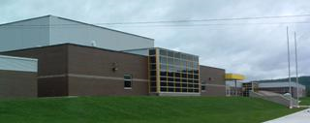
PAMS
School Expectations
2018-2019

Slide 2
Cafeteria expectations
When you enter the building; remove hat, enjoy your breakfast, and find a seat. Stay seated until dismissed.
Stand and sing O Canada
When announcements start, your instructional day begins. Electronics are put away. eyes on speaker, be still and quiet, and listen.
Be sure to put garbage away, and wait to be dismissed by grade. Follow your HR teacher.
The stage and steps are off limits.

Slide 3
Homeroom
Treat Homeroom as a class.
Sit in your assigned seat and arrive before the bell.
Listen to class room announcements, attendance.
You have 5 minutes to fill your water bottles, use the washrooms and get your supplies for period 1/2.

Slide 4
Respect
All adults working in the building are part of a TEAM helping you to succeed.
Listen to our team which includes the administration, teachers, EA’s, SIWS, admin. assistant, custodians and cafeteria staff.
Be polite and kind.

Slide 5
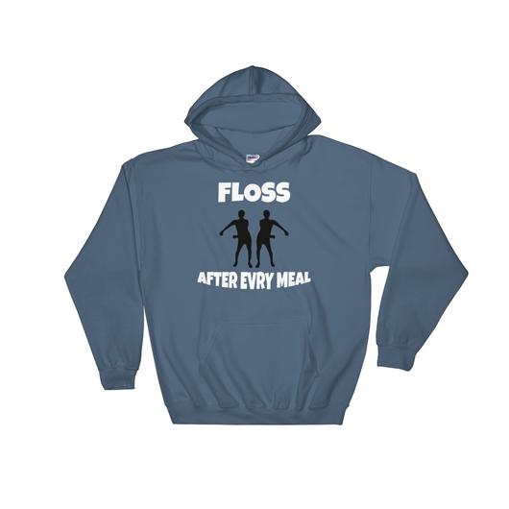
Hats Belong in Your Lockers.
Remove your hat or hood as soon as you enter the building.
Hats are not to be worn at school events such as: dances, activity days and school concerts.

Slide 6
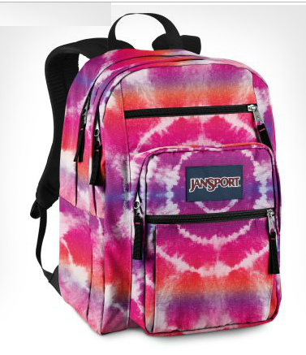
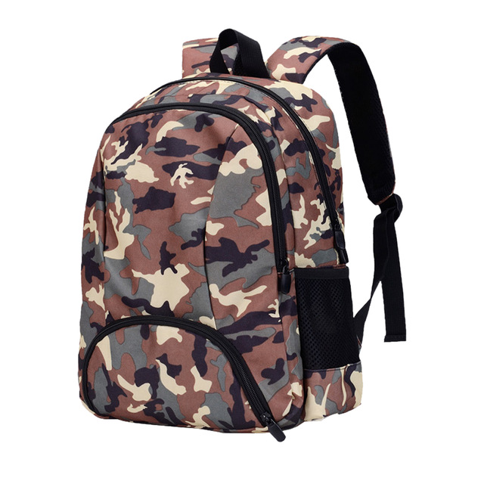
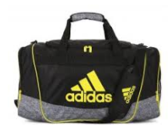
Grade 6/7 students - your book bag belongs in your locker. Grade 8 students - can carry your book bag from class to class.

Slide 7
Cafeteria
8:05- 8:22 breakfast program is available and food must be eaten in the cafeteria.
Cafeteria is open at break and lunch.
Reserve your lunch and pay for it at break.
All students must be seated and clean up after yourself before you leave.

Slide 8
Lunch 12:08 – 1:00
Your choices for eating areas are:
In the Cafeteria
Outside on tables or benches at the top of hill
Sun lobby
The field & swings are off limits until 2nd half of noon
The tech/art wing is closed during noon hour.
Pick up your garbage - Be respectful

Slide 9
Lunch 2nd half 12:29-12:53
Time for fresh air outside
Outside front of school
Sit at outside tables
Play in field (soccer , catch, walking…)
Swings

Slide 10
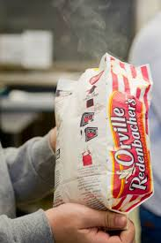
Finish your breakfast, snack and lunch before returning to class. No Food During Class Time.

Slide 11
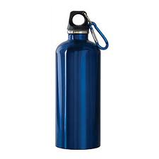
Drink only water in class. Use a refillable water bottle

Slide 12
Energy drinks are not for middle schoolers! They will be taken from you.

Slide 13
Use electronics responsibly - For educational purposes only and with teacher’s permission. Otherwise your phone is away – out of sight! - Not to be seen in the class or halls during class time. This means no phones between classes and end of day while you walk outside. Not following this expectation will result in your device will be taken away and returned only to a parent/guardian at the end of day.

Slide 14
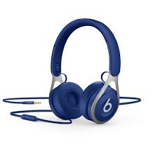
Occasionally you may listen to music or a video for educational purposes using Headphones during class. This is always with a teacher’s permission.

Slide 15
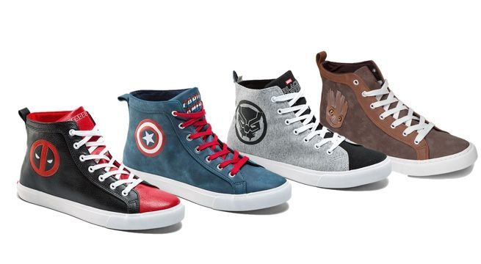
Dress appropriately. - no inappropriate sayings or logos on your clothing. - shoes must be worn at all times.

Slide 16
Washroom
Use the washroom at break and between classes.
Expect your teacher to say “No,” more than they will say “Yes.”

Slide 17
Appropriate behavior
Hands to yourself / no physical contact (no holding hands, piggybacks)
Use appropriate language at all times.
Always walk on the right hand side of the hallway at PAMS

Slide 18
Gym / Tech lab / Computer lab
No food or drink permitted.
Respect all equipment.
Wear appropriate clothing.

Slide 19
Homework
Check the web site / listen to voice mail

Slide 20
Lockers
AM – Bring your books/supplies for Period 1 & 2.
Break – Get your books/supplies for Period 3 and 4.
12:50 – Get your books/supplies for Period 5/6.
Keep your lockers tidy to help you stay organized.

Slide 21
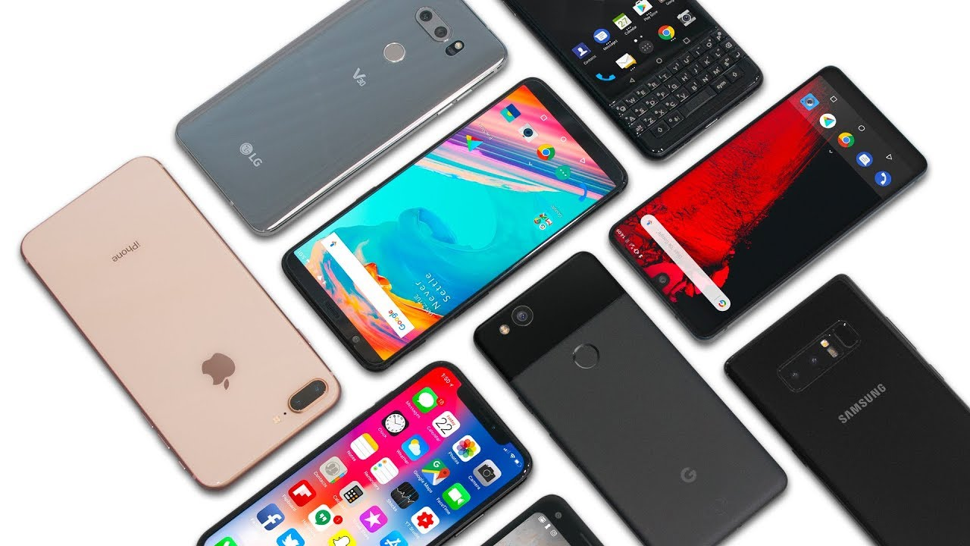
Phones
Use cell or payphones at break and noon for personal calls.
The office will call home if there is an emergency.

Slide 22
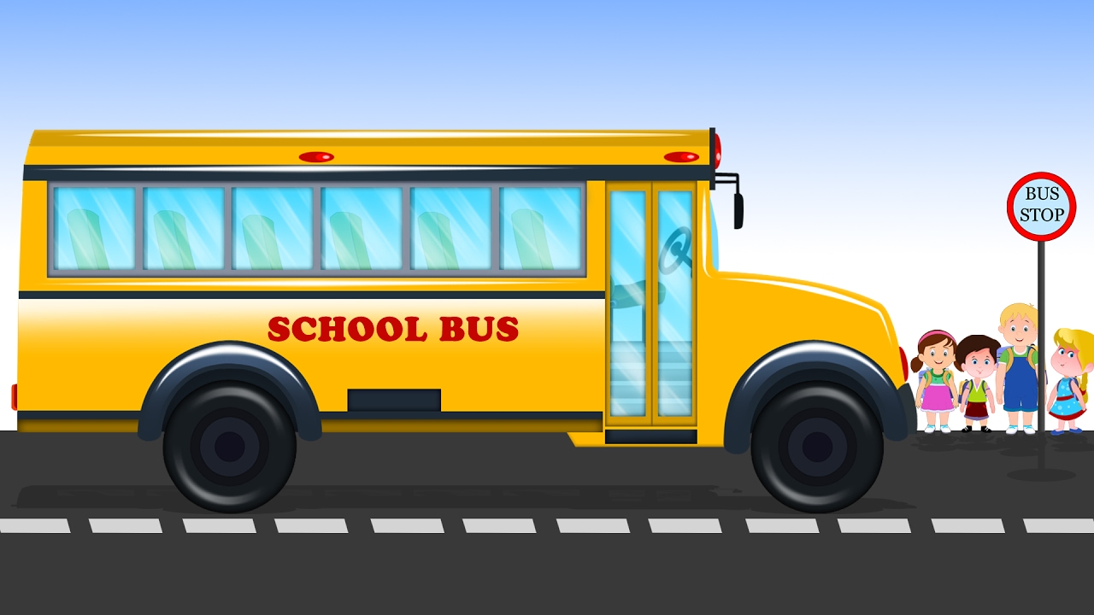
End of the day
Bell will ring At the end of Period 6, 2:42.
students will go to their lockers and then walk to their buses.
Students who walk or bike must wait on the steps until all busses have left the parking lot.

Slide 23
Fire Drill
Your teacher will assign duties
A student/back up closes all windows.
A student/back up closes the class door.
Follow your teacher outside quickly Walking to your assigned spot outside.
Line up and listen for your teacher to take attendance.
Stay in line and wait quietly until you are told to return to class.

Slide 24
New stuff at PAMS - PAMS Student Leadership Committee
PAMS students will help organize fun activities for students
Students will help with monthly assemblies, class challenges, theme days, dances, Christmas concerts, fall festival, winter carnival…
2 different students each month will represent each HR on the committee
First leadership meeting is Wednesday, Period 4.

Slide 25
New Logo

Slide 26
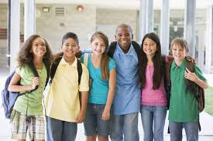
Let’s work together to make PAMS a fun and safe place to learn!

